Slide 1

House Price Forecaster

Slide 2

Collaborators
Maira Syed
Aruna Venkatachalam
Jalees Moeen

Slide 3

Table of Contents
Introduction
Data preprocessing
Tableau Visualization
Machine Learning Model
Flask Powered API
Limitation
Conclusion

Slide 4

Introduction
Forecasting the prices of residential homes in Ames, Iowa, US using machine learning.
This project involves creating a regression model to forecast house prices based on various features.
Notes:
The Ames housing market offers diverse property options catering to a range of buyers, from historic homes to modern developments.
Ames presents an attractive blend of affordability and investment potential in a charming suburban setting."
Our project harnesses the power of machine learning and deep learning techniques to predict house prices accurately.
By leveraging advanced algorithms, we aim to provide users with reliable forecasts based on various property features.

Slide 5

Data Source
Notes:
81 Features, more than 1500 rows
so, to predict the house price we used machine learning model.

Slide 6
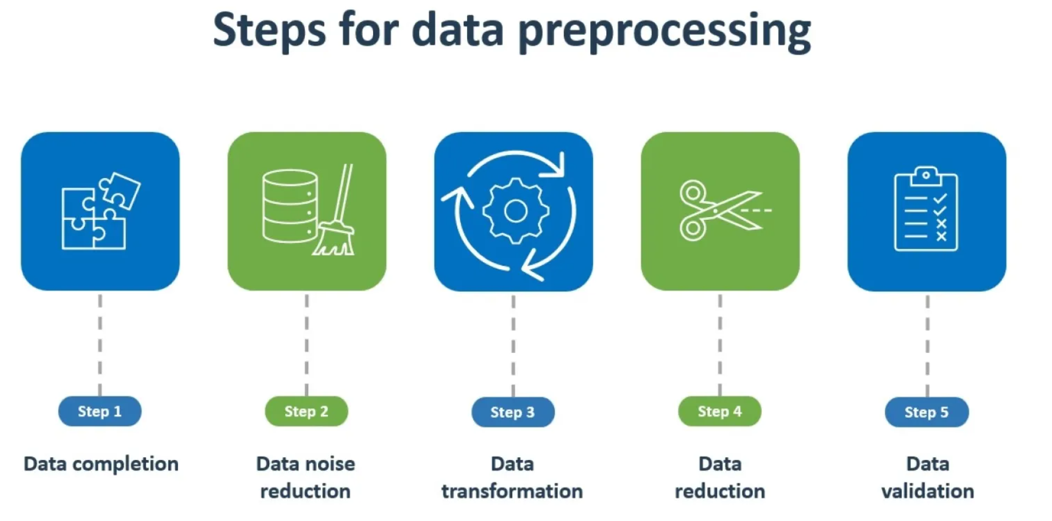
Data preprocessing
Initital Data Preprocessing
Final Data Preprocessing
Notes:
we decided to explore and analyze the data in two stages

Slide 7
Initital Data Preprocessing
Impute Missing values
Apporpriate data types
Binning
Notes:
we decided to explore and analyze the data in two stages

Slide 8
Final Data Preprocessing
Scaled data
Hot Encoding
Notes:
Various exploratory data analysis tasks are conducted to understand the distribution and relationships of different features with the target variable (SalePrice).
Visualizing relationships between certain features and SalePrice using different plots such as line plots, bar plots, and histograms and checking value counts and unique values of different categorical columns like:

Slide 9
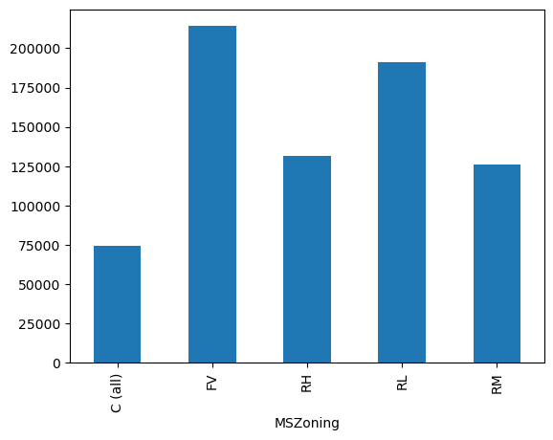
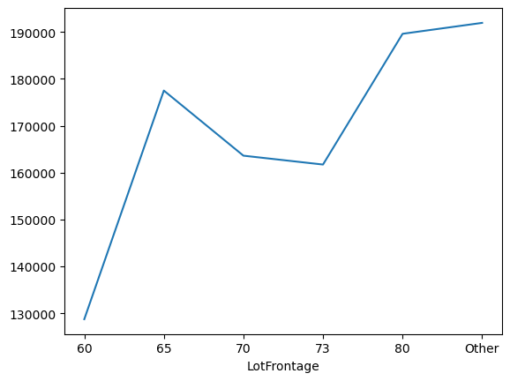
Notes:
Various exploratory data analysis tasks are conducted to understand the distribution and relationships of different features with the target variable (SalePrice).
Visualizing relationships between certain features and SalePrice using different plots such as line plots, bar plots, and histograms and checking value counts and unique values of different categorical columns like:

Slide 10
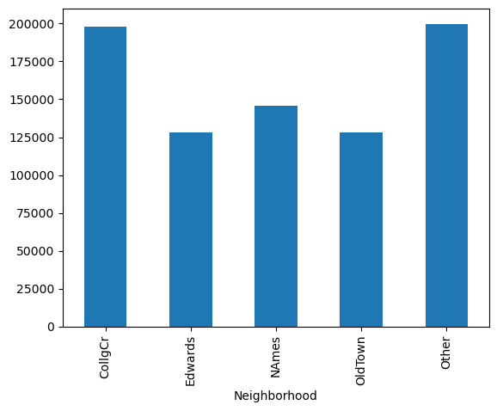
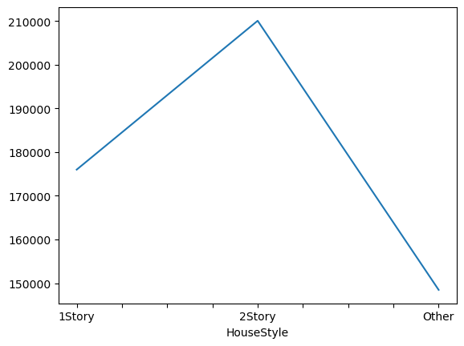
Notes:
Various exploratory data analysis tasks are conducted to understand the distribution and relationships of different features with the target variable (SalePrice).
Visualizing relationships between certain features and SalePrice using different plots such as line plots, bar plots, and histograms and checking value counts and unique values of different categorical columns like:

Slide 11
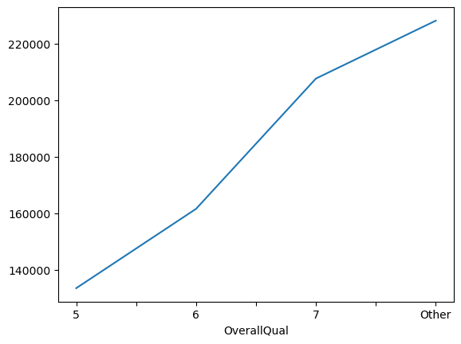
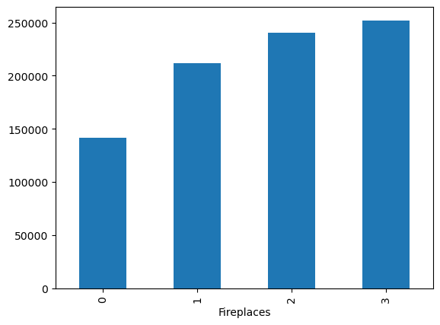
Notes:
Dropping columns that are deemed less relevant or have low correlation with the target variable (SalePrice). These columns are stored in columns_to_drop and are removed from the DataFrame using drop.
The final preprocessed training dataset is exported to both JSON and CSV formats for further analysis or modeling.

Slide 12


Slide 13
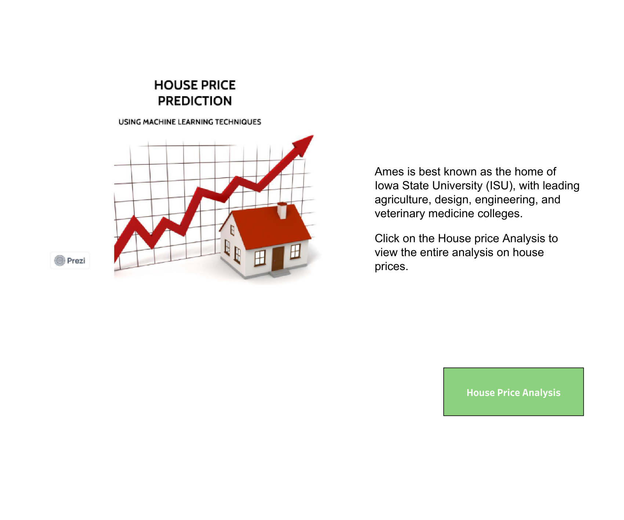

Slide 14
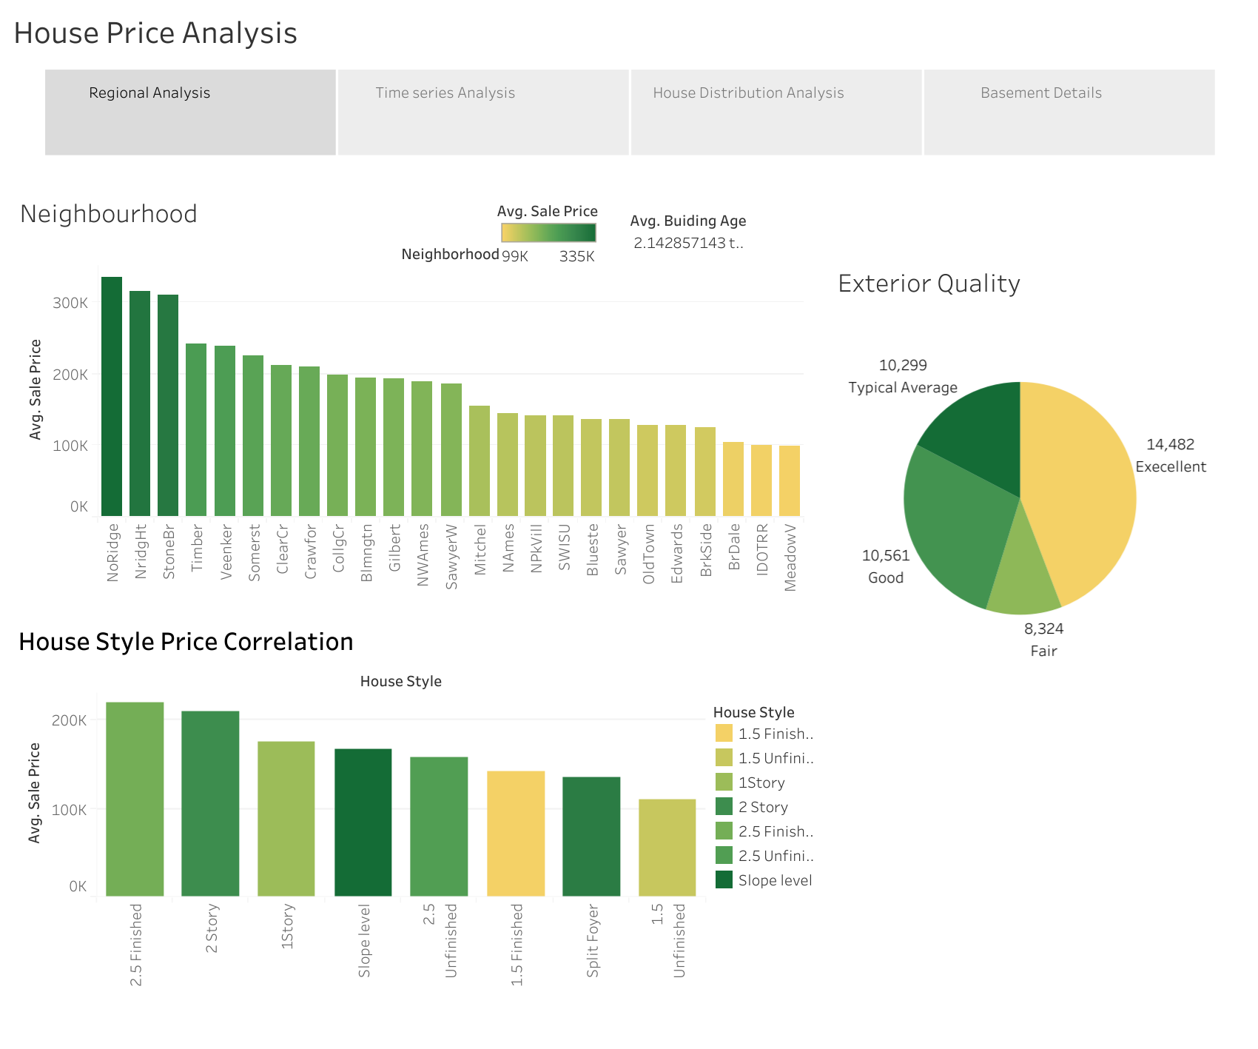
Notes:
From the regional analysis, MeadowV has the lowest average sale price with 98,576 in it's sorrounding, whereas the NoRidge occupy the most highest sales price with 335,295. Most expensive house style is "2.5 finshed" and the economical is the "1.5 Unfinished". The excellent exterior quality keeps on the top prices, where other qualities remains on average.

Slide 15
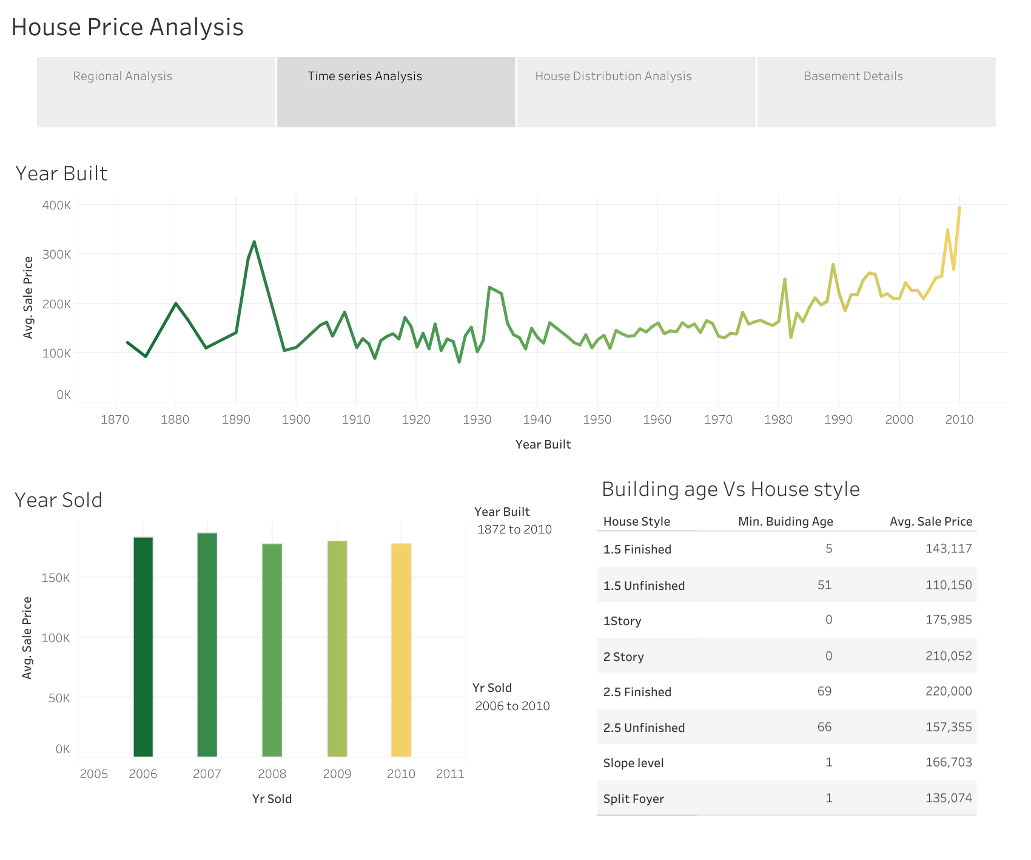
Notes:
The housing prices vary each year based on the year of construction, with a clear trend indicating that newer homes tend to command higher prices. The average sale price for each year of sale remains stable, ranging from $175,000 to $185,000.

Slide 16
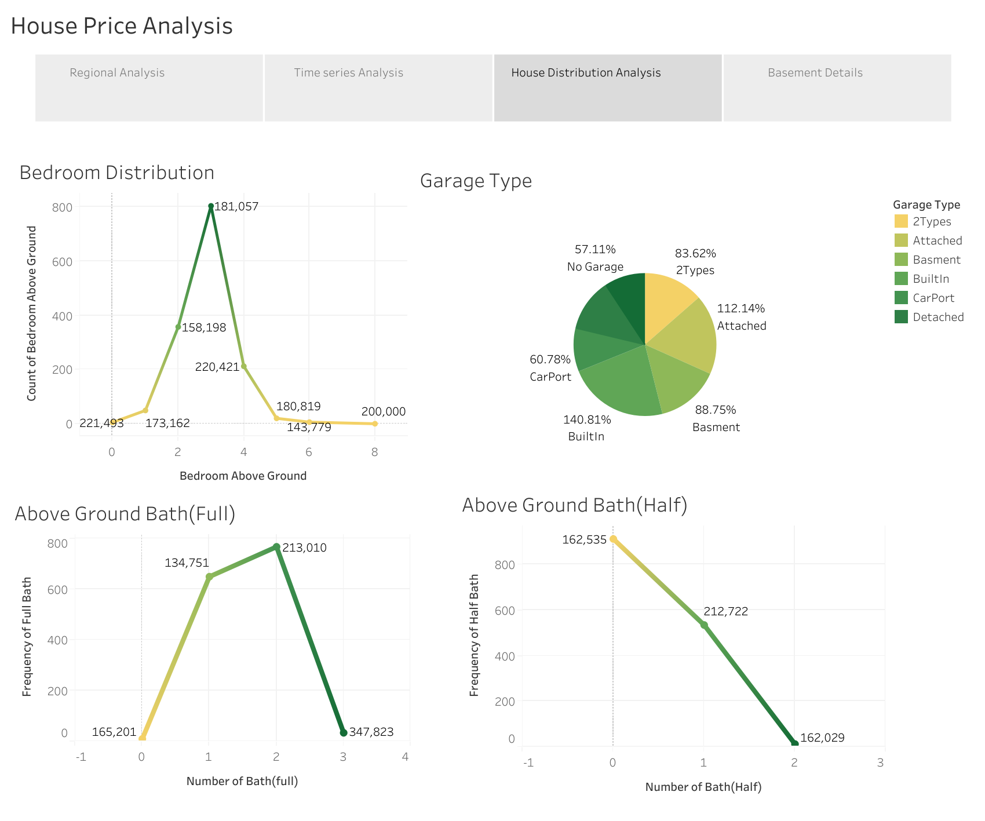
Notes:
The three-bedroom configuration emerges as the most popular, with the highest number of houses featuring three bedrooms. Meanwhile, properties with two bathrooms appear to be in high demand, correlating with a relatively elevated price of 213,010.

Slide 17
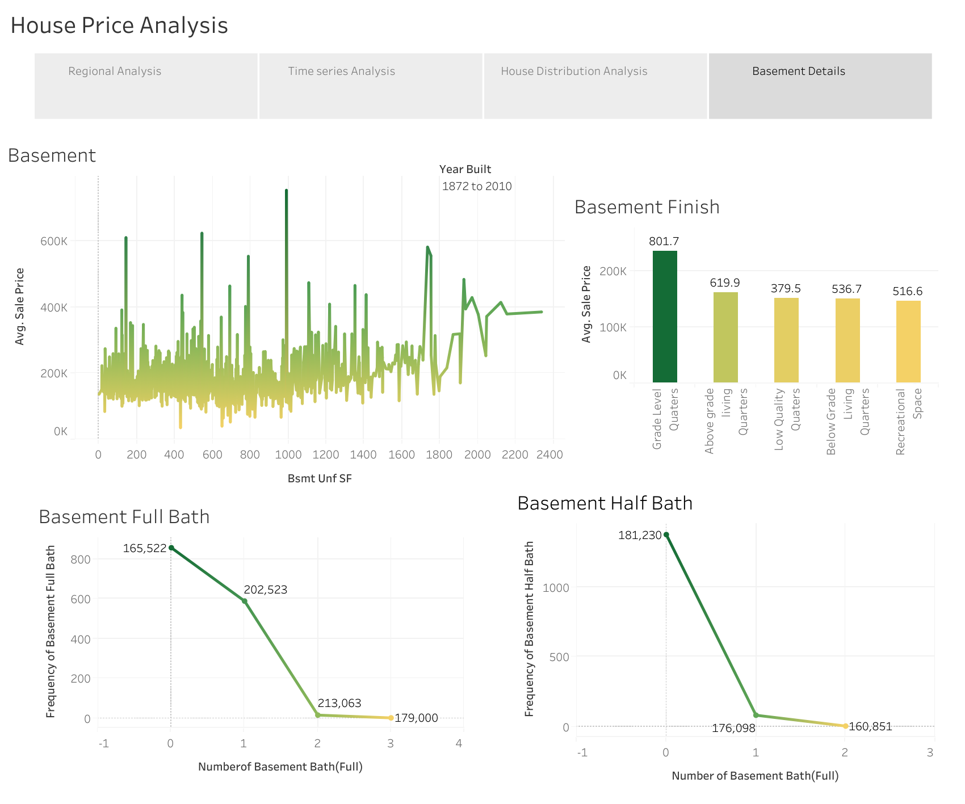
Notes:
The basement area exhibits significant fluctuations. The highest sales price, at $235,414, is observed for Grade Level Quarters, while recreational space records the lowest at $146,889. Above grade Living Quaters - partially or fully above ground level, typically have windows and natural light below ground level have limited or no natural light partially or fully at ground level with direct access to the exterior without stairs or ramps. Similar to ALQ basements LWQ basements are unfinished or minimally finished spaces with basic amenities and limited insulation or ventilation. May be used for storage, utility rooms, or as unfinished living areas designed for entertainment and leisure activities.

Slide 18
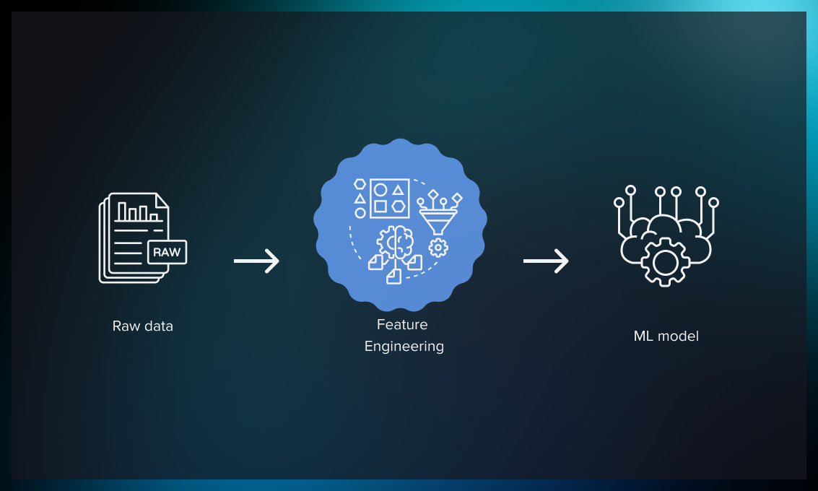
Feature Engineering
Random Forest Regressor
Split and Scale Data
Feature Selection
Notes:
You're loading the preprocessed data from the CSV file.
Separating the target variable (SalePrice) from the features (X).
Scaling the numerical features using StandardScaler.
One-hot encoding the categorical features.
Training a Random Forest Regressor model on the preprocessed data.
Using the trained model to select relevant features based on their importance scores.
Filtering out less important features and storing the selected features in a DataFrame.

Slide 19
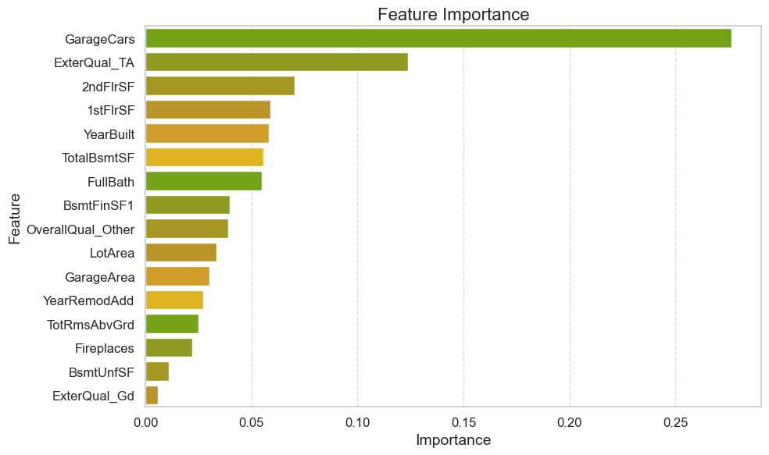
Feature Engineering
Notes:
You're loading the preprocessed data from the CSV file.
Separating the target variable (SalePrice) from the features (X).
Scaling the numerical features using StandardScaler.
One-hot encoding the categorical features.
Training a Random Forest Regressor model on the preprocessed data.
Using the trained model to select relevant features based on their importance scores.
Filtering out less important features and storing the selected features in a DataFrame.

Slide 20

Machine Learning Model
Linear Regression
Neural Network Model
Notes:
After applying a linear regression model to the data, the results indicated limitations in capturing the complex patterns inherent in the dataset.
Recognizing the need for a more sophisticated approach, I transitioned to employing neural network models.
Unlike linear regression, neural networks leverage hidden layers to extract intricate patterns and relationships within the data.
This capability allows neural networks to deliver superior predictive performance by mimicking the learning process observed in human cognition.

Slide 21
Neural Network Model
Initial Data
Final Data (Selected Features)
Notes:
Target variable(s) for the model: The model aims to predict the SalePrice variable.
Feature variable(s) for the model: The model incorporates various feature variables such as MSSubClass, MSZoning, LotFrontage, LotArea, Neighborhood, HouseStyle, OverallQual, OverallCond, MasVnrType, MasVnrArea, ExterQual, BsmtQual, TotalBsmtSF, Fireplaces, and others.
Variable(s) removed from the input data: The Id column was removed from the input data as it serves as an identification column and does not contribute as a feature or target.
Target variable(s) for the model: The model aims to predict the SalePrice variable.
Feature variable(s) for the model: The model incorporates various different features compared to the initial data. These features are specific to the model includes variables like GarageCars, 2ndFlrSF, 1stFlrSF, YearBuilt, FullBath, BsmtFinSF1, OverallQual_Other, GarageArea, YearRemodAdd, and TotRmsAbvGrd, which are not present in the inital data. Additionally, there are some common features like LotArea and Fireplaces present in both data.
Variable(s) removed from the input data: The Id column was removed from the input data as it serves as an identification column and does not contribute as a feature or target.

Slide 22
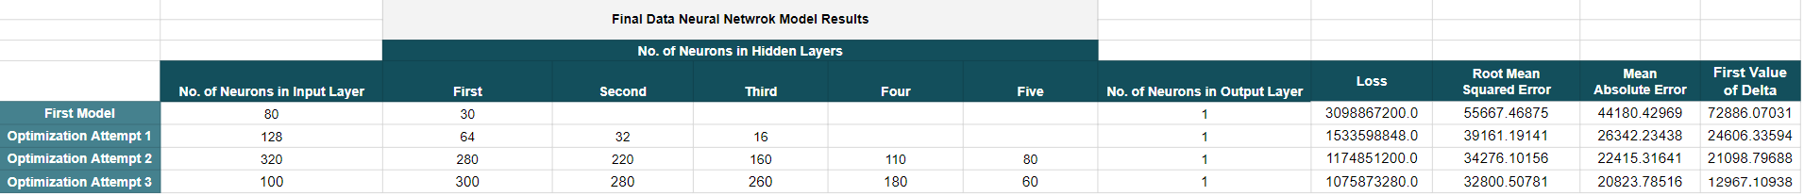
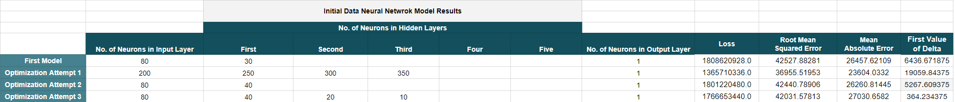
Notes:
Change in data
Number of neurons
Layers
Activation function
Epochs
Optimizing technique – randomized search

Slide 23
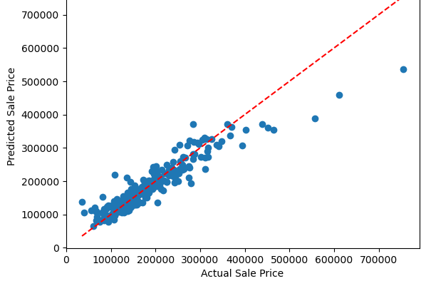
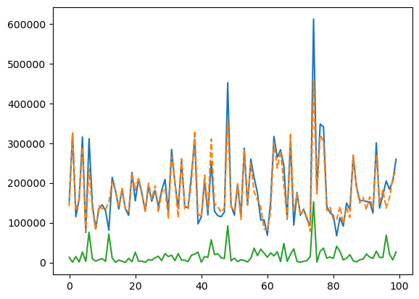
Actual Vs Predicted

Slide 24

Flask App

Slide 25


Slide 26

Limitation
Limited data till 2010
Overfitting
Notes:
The higher number of features but with missing values that lead to overfitting of the linear regression model. The data is only from 1972 to 2010, no recent data available.

Slide 27
Conclusion
Notes:
After facing challenges with the linear regression and attempting to refine it with selected features from a random forest regressor, we decided to explore a neural network model using the original dataset. Despite our efforts to optimize the neural network model, the Mean Squared Error (MSE) remained unsatisfactory. However, upon integrating the selected features from the random forest regressor into the neural network architecture and further optimization, we managed to achieve a RMSE of 32800.50781 MSE of 20823.78516 with a loss of 1075873280.0.

